Slide 1

Stock Analysis AI Agent
An Integrated Tool for Stock Market Insights By Azhima Koraji

Slide 2

Introduction
Purpose: Provide a comprehensive stock analysis using AI tools
Who can use: Financial analysts, investors, and decision-makers
Tool List:
Historical stock price trends
Financial metrics evaluation
Stock price forecasting
Sentiment analysis
Volatility analysis

Slide 3
Tool Functionalities
Stock Price Analysis:
Retrieves historical data and calculates indicators like RSI, MACD, and VWAP.
Financial Metrics:
Extracts critical ratios such as P/E, price-to-book, and profit margins.
Sentiment Analysis:
Analyzes news headlines for sentiment trends.
Volatility Metrics:
Computes annualized volatility and max drawdown.
Forecasting:
Predicts stock prices using Exponential Smoothing models.
Peer Comparison:
Benchmarks a stock against its industry peers.

Slide 4



Technology
Python
Streamlit
yfinance

Slide 5




Key Components
Agent
TOOLS
WORKFLOW
Main

Slide 6
System Workflow
User Query: Input stock symbol and questions.
Agent Workflow:
Trigger relevant tools based on the query.
Use llm for decision-making.
Output: Structured, actionable insights displayed via Streamlit.

Slide 7
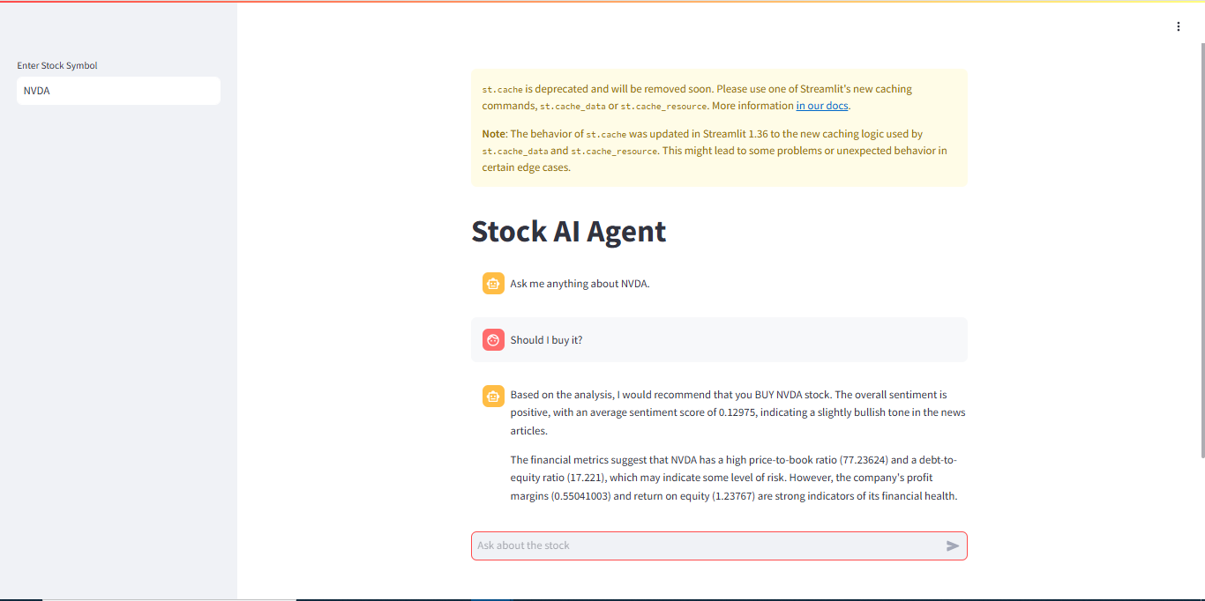
DEMO
Input Stock
Ask Question
AI agent answer

Slide 8
END

Slide 9
Thank you
someone@example.com

